Slide 1
Working with NuGet Packages

Slide 2
Packages
Collection of artifacts to use in your software development pipeline
Like a present from the internet
Sometimes with a pretty bow
Internal or External

Slide 3
Package Manager
Application to track/install/uninstall packages locally
Also for versioning
NuGet, Packet, NPM, Yarn, Brew, etc

Slide 4
Consuming a NuGet Package
2 ways to track packages
Packages.config file
PackageReference
Settings are per-project

Slide 5
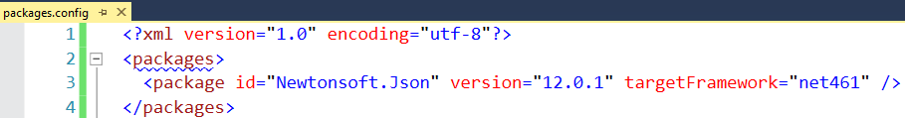
Packages.config
XML file in project directory
Packages downloaded locally per-solution
<SOLUTION ROOT>/packages
Default Choice in Visual Studio
Not meant for live edits
Legacy/Not supported for .NET Core/Standard

Slide 6
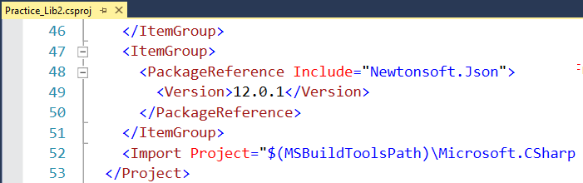
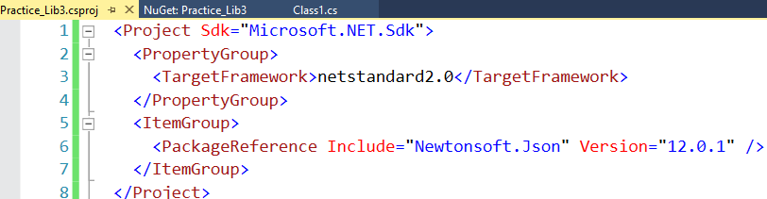
PackageReference
Stored in Project file
Packages downloaded/shared globally on local machine
`dotnet nuget locals all --list`
Only choice for .NET Core/Standard
.NET Framework Project
.NET Standard Project

Slide 7
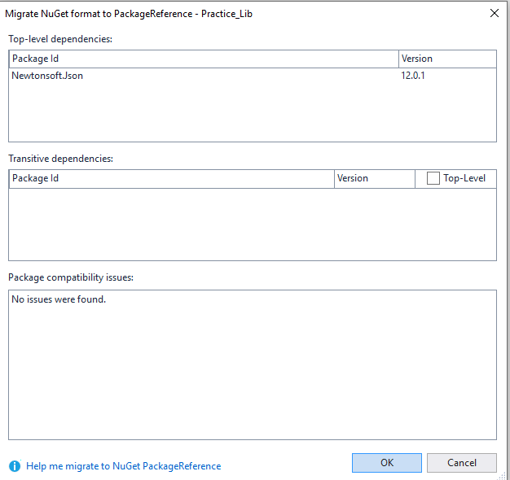
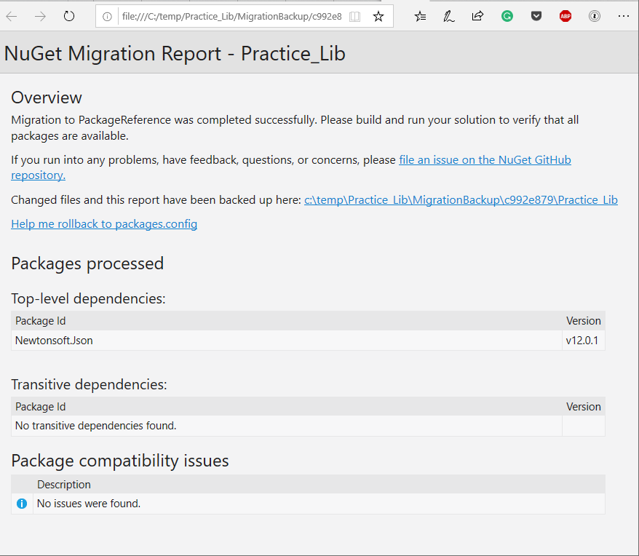
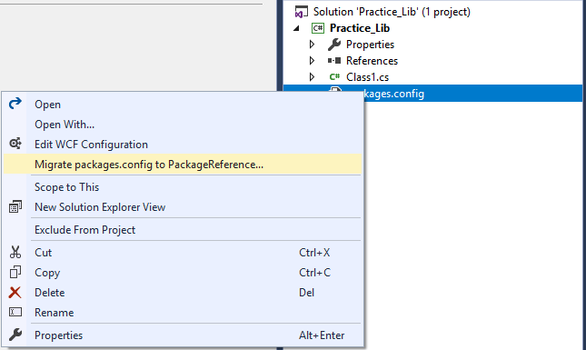
Migrating Packages.config to Package Reference
Analyzer
Report
Built into Visual Studio
Analyzer runs first
HTML report after migration
Right Click Packages.config

Slide 8
PackageReference Breaking Changes
File references only
No install.ps1 and uninstall.ps1 script execution
Files in ‘content’ folder not automatically added to project

Slide 9
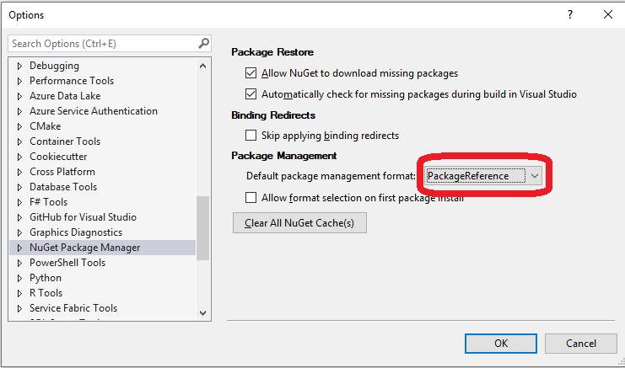
Make PackageReference the Default

Slide 10
Creating a NuGet Package: .NET Framework
In Visual Studio, Fill out info for Application (project properties)
Also info inside “Assembly Information…” button
Compile Library
Download nuget.exe
From within Project Folder, Run command: nuget spec
Generates .nuspec file
Update .nuspec file if needed
From within project folder, Run command: nuget pack

Slide 11
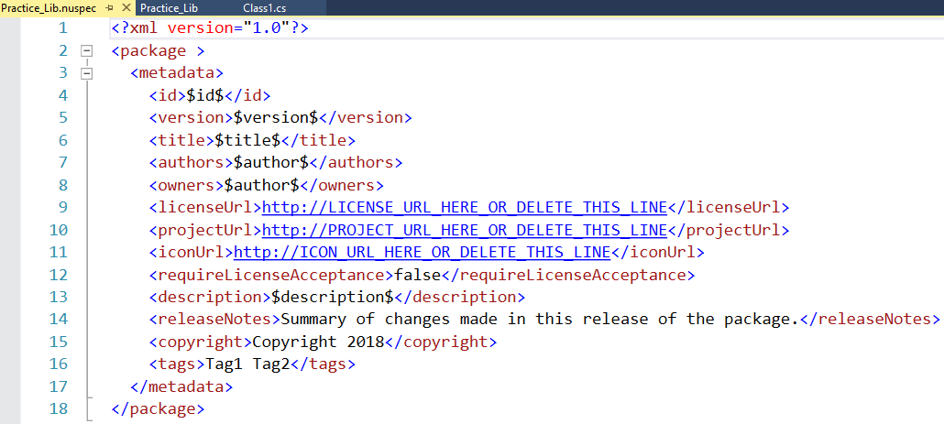
Sample .nuspec file for project
Generated with nuget.exe
Some properties taken from project data
Not all properties required

Slide 12
Creating a NuGet Package: .NET Standard
In Visual Studio, Fill out info for Package (project properties)
Right Click project -> Pack
See package created at:
<Project>\bin\Debug\Practice_Lib3.1.0.0.nupkg
Note: Can do similar work with dotnet CLI

Slide 13
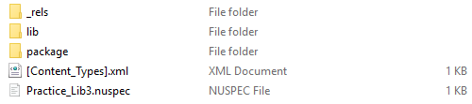
Anatomy of a NuGet Package
Files!
Package is a zip folder
Folder Structure – Not Well Documented
Lib/Content/Build/Tools

Slide 14

Publishing a Package
Let others consume a package to their project
Can “Push” to NuGet server
Command line, or Visual Studio (.NET Standard only)
Setup CI/CD Pipeline

Slide 15
Challenges - Publishing in CI/CD Environment
Can’t change version number after file creation
Can’t change any files after file creation

Slide 16
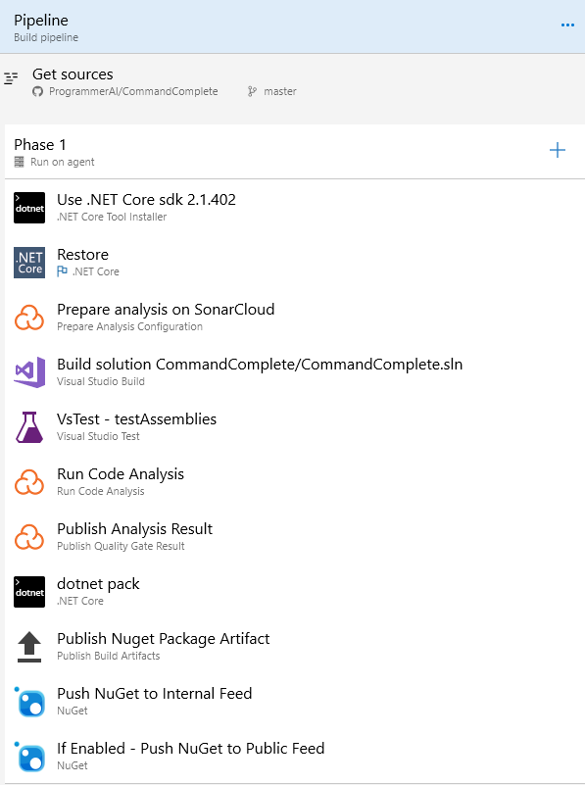
Publish Pipeline in Azure DevOps

Slide 17
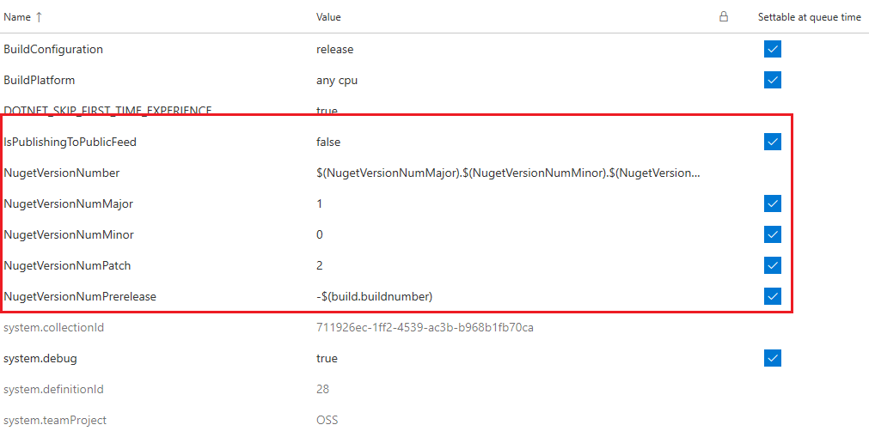
Pipeline Variables

Slide 18
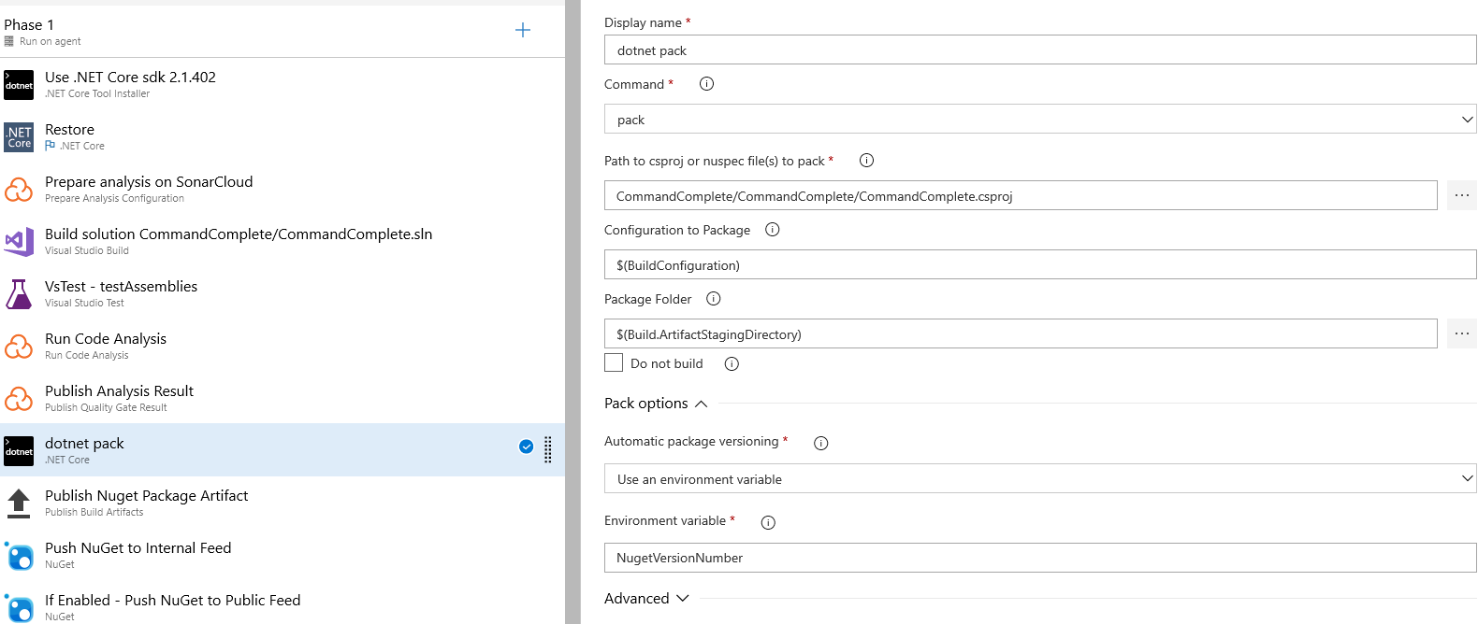
Step 8 – dotnet pack

Slide 19
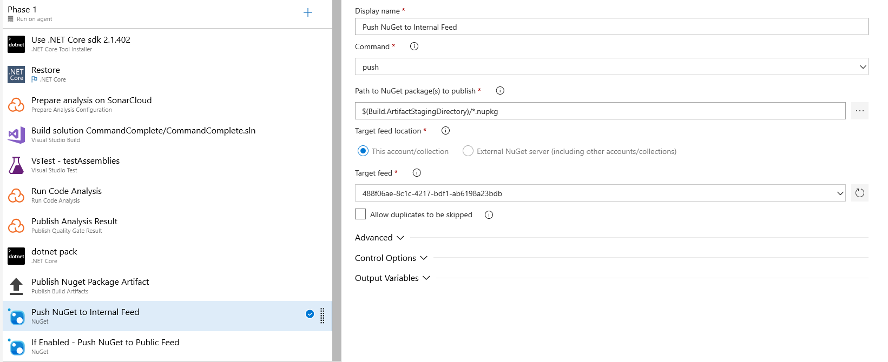
Step 10 – Push to Internal NuGet Feed

Slide 20
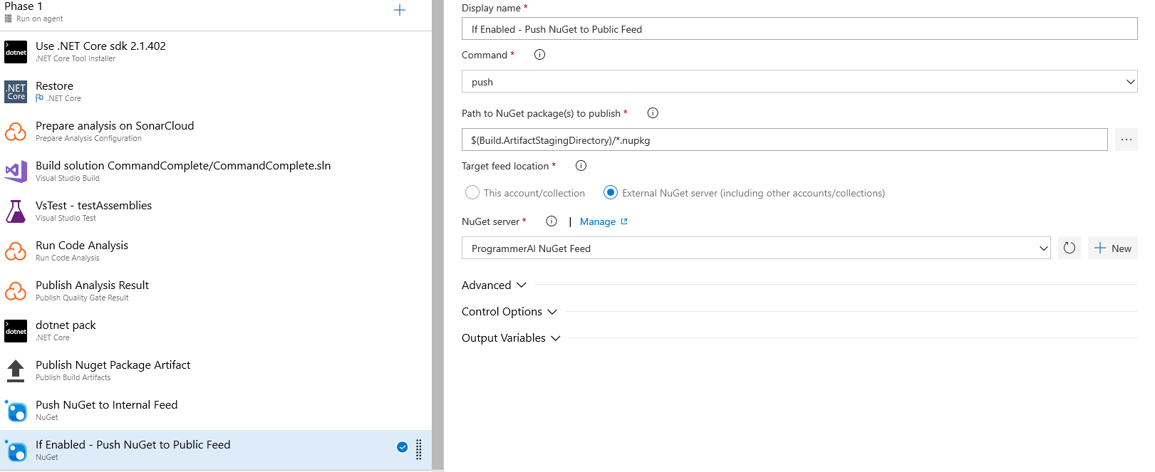
Step 11 – Push to Public NuGet Feed

